Slide 1


SMART INDIA HACKATHON 2026
VERIFEX AI : AI-Powered Identity & Document Forensics for Secure Border Screening
Problem Statement ID – 26023
Problem Statement Title- Al-Based Fake Identity & Document Screening System
Theme- Blockchain & Cybersecurity
PS Category- Software
Team ID-
Team Name- RISU NEXORA
“Turning remote access into a fortress — not a doorway.”

Slide 2

RISU NEXORA
VERIFEX AI
Our Idea
VERIFEX AI is an integrated screening platform that analyzes identity and travel documents using multiple verification layers:
Extract → Validate → Forensically Analyze → Verify Identity → Assess Risk → Audit
It combines: OCR + MRZ Validation + Document Rules + AI Image Forensics + Face Verification + Risk Assessment + TEE + Blockchain
How It Addresses the Problem
Innovation & Uniqueness
Current
workflow
Passenger
↓
Manual Document Inspection
↓
Read Information
↓
Basic Database Check
↓
Manual Face Comparison
↓
Officer Decision
VERIFEX AI
workflow
Document + Person
↓
VERIFEX AI
↓
┌─────┼──────┐
↓ ↓ ↓
OCR Rules AI Forensics
│ │ │
└─────┼──────┘
↓
Face Verification
↓
Risk Assessment
↓
Explainable Result
↓
Officer Decision
↓
Blockchain Audit
KEY INNOVATION
① Cross-Document Intelligence
Passport ↔ Visa ↔ Identity consistency
② Evidence-Based Forensics
Detects suspicious photo/text/stamp manipulation and identifies supporting evidence
③ Privacy-Preserving AI
TEE protects sensitive biometric and AI processing
④ Tamper-Evident Audit
Blockchain records verification hashes and audit events
System can build a relationship graph between all available identity documents and the person.
Outcome
Faster Screening + Explainable Verification + Stronger Fraud Detection + Secure Audit Trail
“Zero Trust for Remote Access - Built in India, for India.”

Slide 3
RISU NEXORA
VERIFEX AI
Technology Stack
Frontend
→ React
Backend
→ Python + FastAPI
OCR
→ Paddle OCR /
Tesseract
Computer Vision
→ OpenCV + PyTorch
Face Verification
→ Face Embedding
Model
Database
→ PostgreSQL
Blockchain
→ Permissioned
Blockchain
Trusted Computing
→ TEE
Deployment
→ Docker
Technologies to be Used
Methodology & Process
Document Capture – Capture passport, visa, ID, permit and live face image.
OCR & MRZ Extraction – Extract and read identity details using OCR and MRZ.
Document Validation – Check format, expiry, fields and document authenticity.
AI Tampering Detection – Detect altered photos, text, stamps and image manipulation.
Face Verification – Compare the document photo with the live person.
Identity Consistency Graph – Cross-check identity details across multiple documents.
Risk Assessment – Combine all verification results to generate an identity-risk level.
Officer Verification – Present explainable evidence for the officer's final decision.
TEE Security – Protect sensitive biometric and AI processing.
Blockchain Audit – Store verification hashes and audit records in a permissioned blockchain.
AI & Machine Learning
Python
PyTorch / TensorFlow – AI model development
Computer Vision – document image analysis and tampering detection
Face Recognition / Face Embeddings – face verification
OCR & Document Processing
PaddleOCR / Tesseract – text extraction
OpenCV – image preprocessing, document alignment and image forensics
MRZ Parser – passport machine-readable zone validation
Database & Validation
PostgreSQL – secure storage of verification metadata
Rule Engine – document format, expiry, DOB and cross-document validation
Cybersecurity
TEE (Trusted Execution Environment) – secure processing of sensitive/biometric data
AES/TLS Encryption – data protection
RBAC + JWT – secure access control
Blockchain
Hyperledger Fabric / Permissioned Blockchain – tamper-evident verification and audit records
SHA-256 Hashing – document integrity verification
“Engineered for real-world resilience — designed to adapt, not fail.”

Slide 4
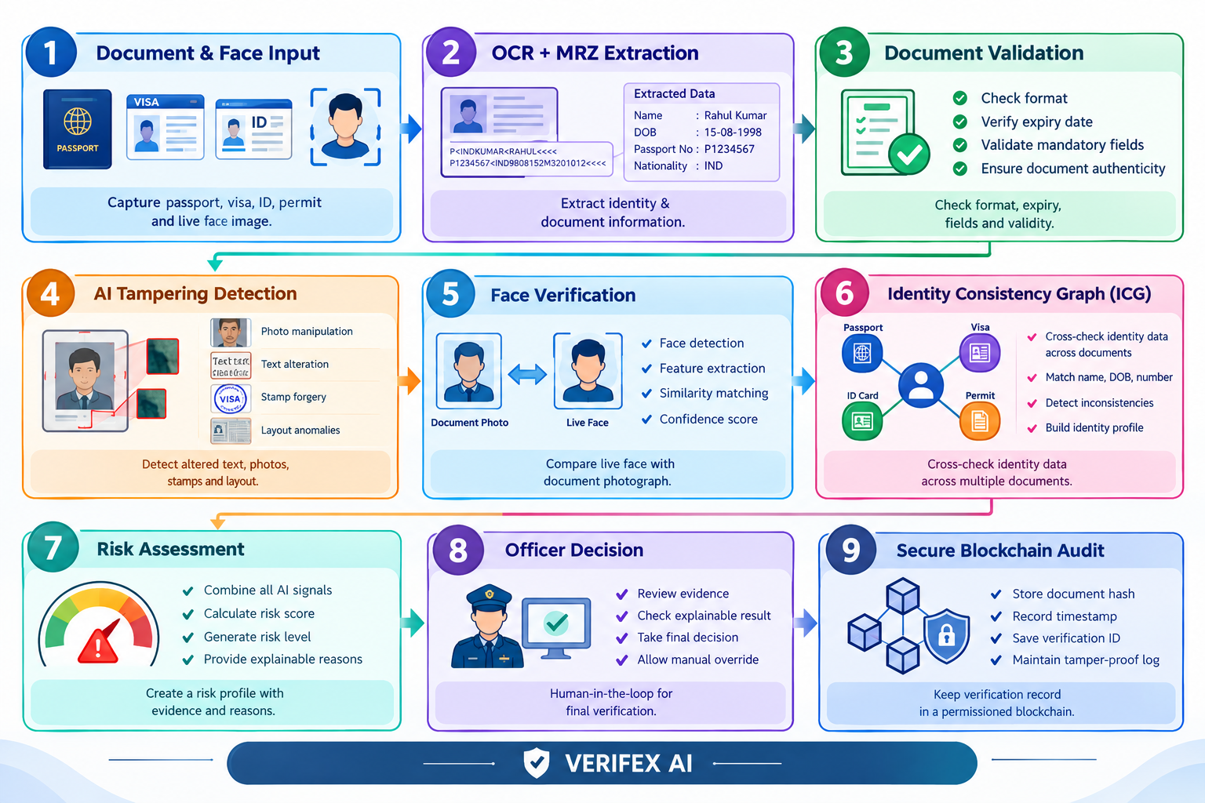
RISU NEXORA
VERIFEX AI
“Empowering India’s cyber shield — securing every connection, every mission.”

Slide 5
RISU NEXORA
VERIFEX AI
Feasibility of the Idea
Technically Feasible Uses Proven AI
Technologies Modular & Scalable Architecture
Low-Cost Prototype Using Open-Source Tools
Secure Data Processing
Real-Time Verification Capability
Human-in-the-Loop Decision Making
Future Integration with Authorized Databases
Strategies to Overcome Challenges
Challenge | Our Strategy
Forged & tampered documents | AI-based image forensics and anomaly detection
Poor-quality document images | Image preprocessing, enhancement and alignment
OCR errors | OCR + MRZ cross-validation
Identity impersonation | Face verification with confidence scoring
Multiple document inconsistencies | Identity Consistency Graph (ICG)
Sensitive biometric data | TEE, encryption and secure processing
High passenger volume | Automated, real-time verification pipeline
Data integrity & auditability | Permissioned blockchain with hashed records
Impact on target audience
Faster Verification
Improved Security
Accurate Identification
Reduced Workload
Transparent Screening
“Rooted in research. Reinforced by innovation. Ready for deployment.”

Slide 6
VERIFEX AI
RISU NEXORA
Long-Term Strategic Value
PHASE 1
Capture & Digitize
↓
PHASE 2
Extract & Validate
↓
PHASE 3
AI Forensics & Face Verification
↓
PHASE 4
Identity Consistency & Risk Analysis
↓
PHASE 5
Secure Decision & Blockchain Audit
  Benefits of the solution
Faster Screening – Reduces verification time from minutes to seconds.
Enhanced Fraud Detection – Identifies forged, altered and suspicious documents.
Accurate Identity Verification – Cross-checks documents with live facial identity.
Reduced Manual Effort – Automates repetitive verification and validation tasks.
Explainable Risk Assessment – Provides clear reasons behind suspicious flags.
Secure & Privacy-Preserving – Protects sensitive identity and biometric data.
Tamper-Proof Audit Trail – Maintains trusted verification records using blockchain.
Mined from the core. Mastered by algorithms. Made for impact.

